Slide 1
Recruit, Select, and Support: Turnaround Leader Competencies
Part 1: Understanding Turnaround Leader Competencies

Slide 2
Introductions, Agenda, and Outcomes

Slide 3
Using Turnaround Leader Competencies
Professional Learning Module
Recruit, Select, and Support: Turnaround Leader Competencies
Part 1: Understanding Turnaround Leader Competencies
Part 2: Recruiting and Selecting Turnaround Leaders
Part 3: Developing and Supporting Turnaround Leaders

Slide 4
Partner Organizations

Slide 5
Introductions
Your Name
Your Role
Characteristic of a Turnaround Principal

Slide 6
Part 1: Outcomes
Acknowledge the unique challenges of leading school turnaround.
Identify leader competencies and actions associated with turnaround success.
Understand the importance of competencies in turnaround leader selection and development.
Analyze school leader behaviors to identify evidence of competencies.

Slide 7
Part 1: Agenda
Introductions, Agenda, and Outcomes
Leading Turnaround
Turnaround Leader Actions
Turnaround Leader Competencies
Talent Development Framework
Closing and Next Steps

Slide 8
Leading Turnaround

Slide 9
Turnaround Leader Competencies
Driving for Results
Achievement / Focus on Sustainable Results
Influencing for Results
Impact and Influence
Problem Solving
Analytical Thinking
Conceptual Thinking
Monitoring & Directiveness / Holding People Accountable
Initiative & Persistence
Planning Ahead
Personal Effectiveness
Team Leadership / Engaging the Team
Developing Others
Self-Confidence / Commitment to Student Learning
Belief in Learning Potential
(Public Impact, 2008; Spencer & Spencer, 1993; UVA Partnership for Leaders in Education, 2014)

Slide 10
Activity: Video Response to the Turnaround Principal
The Principal’s Story
Turn and Talk: What are some of the unique challenges that turnaround principals face?
Notes:
Link to the video: http://www.wallacefoundation.org/principal-story/clips-from-the-film/Pages/default.aspx

Slide 11
Leveraging Leaders
“The importance of leadership begs the questions of how to identify, support, and retain high quality principals, especially in turnaround schools where their influence is needed most.”
(Zhu, Hitt, & Woodruff, 2015, p. 4)
Notes:
Click to add notes

Slide 12
Activity: What Sets Turnaround Leaders Apart?
Leading in Higher- Performing School
Leading in Turnaround School

Slide 13
Turnaround Leaders
“Turnaround efforts are made when organizations are in a state of entrenched failure.
Leaders who would otherwise succeed often fall short in a turnaround.”
(Steiner & Hassel, 2011, p. 2)

Slide 14
Turnaround Leader Actions

Slide 15
Activity: Text Review
Individually: Read The Big U-Turn article and highlight words and phrases that resonate with you.
Table groups discuss: What stands out to you about the cross-sector research and actions of turnaround leaders?
Whole group debrief: What did your groups discuss?

Slide 16
Turnaround Leader Actions
Focus on a Few Early Wins; Use the Momentum
Lead a Turnaround Campaign
Get the Right Staff; Right the Remainder
Drive Decisions with Open-Air Data
Break Organization Norms
Do What Works; Raise the Bar
Material adapted from SchoolTurnarounds.org ©Public Impact 2015.

Slide 17
Debrief: Turnaround Leader Actions
How well do these actions align with those distinguishing characteristics you identified earlier?
What does this confirm for you?
What surprises you?

Slide 18
Turnaround Leader Competencies

Slide 19
Competencies
Competencies are underlying motives and habits—or patterns of thinking, feeling, acting, and speaking—that cause a person to be successful in a specific job or role.
Competencies lead to actions that lead to outcomes.
Competencies explain some of the differences in performance levels of leaders.
(Steiner & Hassel, 2011)

Slide 20
Competencies
“Competency research suggests that outstanding performance in complex jobs—ones in which most candidates have a similar educational history and significant autonomy over daily work tasks—is driven more by underlying competencies than by readily observed skills and knowledge.”
(Steiner & Hassel, 2011, p. 5)

Slide 21
Video: Turnaround Leader Competencies
Watch Center on School Turnaround Video of Principal Michael Cormack
Turn and Talk: What actions and competencies stand out to you?
Notes:
Video link: http://schoolturnaroundsupport.org/resources/turnaround-principal

Slide 22
Turnaround Leader Competencies
Key Competencies
Achievement/Focus on Sustainable Results
The drive and actions to set challenging goals and reach a high standard of performance despite barriers
Taking responsibility to improve school outcomes and implement initiatives to accomplish sustainable results
Impact and Influence
Acting with the purpose of affecting the perceptions, thinking, and actions of others

Slide 23
Turnaround Leader Competencies
Key Competencies
Team Leadership/Engaging the Team
Assuming authoritative leadership of a group for the benefit of the organization
Working with a group to leverage their input, develop actionable goals, and implement change in a school
Conceptual Thinking
The ability to see patterns and links among seemingly unrelated things
Analytical Thinking
The ability to break things down in a logical way and to recognize cause and effect

Slide 24
Activity: Analyze Case Study for Turnaround Leader Competencies
Read the case study.
Identify evidence of competencies by underlining words or phrases.
Note which competency you observe in the margin.
Mark with one or two plus signs (++) for evidence of strength in the competency.
Mark with one or two minus signs (- -) for evidence of weakness in the competency.
Discuss your findings.

Slide 25
Talent Development Framework

Slide 26
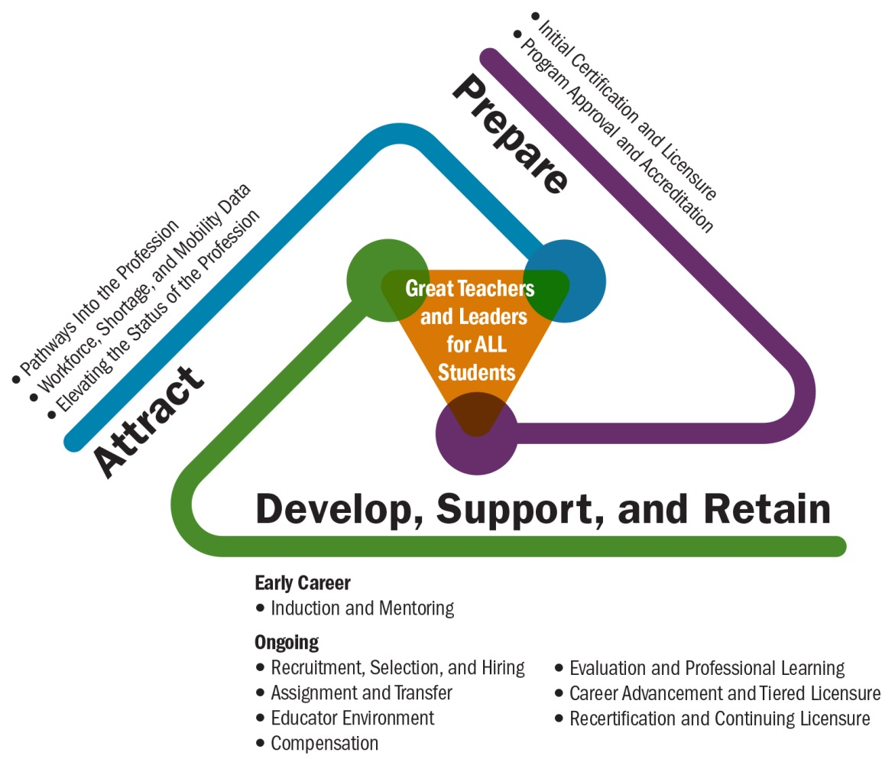
Talent Development Framework
(Center on Great Teachers and Leaders, 2014)
(Center on Great Teachers and Leaders, 2014)

Slide 27
Talent Development Framework
Turn and Talk
How does the talent development framework apply to turnaround leaders?
Where do turnaround leader competencies fit within this framework?
How does this compare with what you have in place?
What are some ways that states and districts can leverage this framework to increase the success of turnaround leaders?

Slide 28
Closing and Next Steps

Slide 29
Wrap-Up: Reflection
3-2-1
3 Ideas
2 Questions
1 Action

Slide 30
Using Turnaround Leader Competencies
Professional Learning Module
Recruit, Select, and Support: Turnaround Leader Competencies
Part 1: Understanding Turnaround Leader Competencies
Part 2: Recruiting and Selecting Turnaround Leaders
Part 3: Developing and Supporting Turnaround Leaders

Slide 31
References
Brinson, D., Kowal, J., & Hassel, B.C. (Public Impact). (2008). School turnarounds: Actions and results. Retrieved from http://www.centerii.org/survey/downloads/Turnaround%20Actions%20and%20Results%203%2024%2008%20with%20covers.pdf
Center on Great Teachers and Leaders. (2014). Talent development framework for 21st century educators: Moving toward state policy alignment and coherence. Washington, DC: Author. Retrieved from http://www.gtlcenter.org/talent_development_framework
Hassel, E. A., & Hassel, B. (2009). The big U-turn: How to bring schools from the brink of doom to stellar success. Education Next. 9(1). Retrieved from http://educationnext.org/files/ednext_20091_20.pdf
Hitt, D. H. (forthcoming). Beyond turnaround: Positioning schools for ongoing growth. Charlottesville: Center for School Turnaround & University of Virginia’s Darden/Curry Partnership for Leaders in Education.
Kowal, J. & Hassel, E. A. (Public Impact). (2005). Turnarounds with new leaders and staff. Washington, DC: Center for Comprehensive School Reform and Improvement. Retrieved from http://www.schoolturnaround.org/PUBLIC%20Impact%20-%20Turnarounds%20with%%20New%20Leaders.pdf

Slide 32
References
Leithwood, K., Louis, K. S., Anderson, A., & Wahlstrom, K. (2004). How leadership influences student learning. Toronto: Center for Applied Research and Educational Improvement and Ontario Institute for Studies in Education.
Public Impact. (2008). School turnaround leaders: Competencies for success. Chapel Hill, NC: For the Chicago Public Education Fund. Retrieved from http://publicimpact.com/web/wp-content/uploads/2009/09/Turnaround_Leader_Competencies.pdf
Spencer, L. M., & Spencer, S. M. (1993). Competence at work: Models for superior performance. New York: John Wiley and Sons, Inc.
Steiner, L., & Hassel, E. A. (Public Impact). (2011). Using competencies to improve school turnaround principal success. Charlottesville: University of Virginia’s Darden/Curry Partnership for Leaders in Education. Retrieved from www.DardenCurry.org Using Competencies to Improve School Turnaround Principal Success
Zhu, G., Hitt, D. H., & Woodruff, D. (forthcoming). Principal competencies that make a difference: Identifying a model for leaders of school turnaround. Charlottesville, VA: University of Virginia’s Darden/Curry Partnership for Leaders

Slide 33
Partner Organizations
For more information on the Partner Organizations:
Center on Great Teachers and Leaders http://www.gtlcenter.org/
Center on School Turnaround http://centeronschoolturnaround.org/
Public Impact http://publicimpact.com/
Darden/Curry Partnership for Leaders in Education http://www.darden.virginia.edu/darden-curry-ple/

Slide 34
Presenter Name
Address
Phone
Email
Website

